Slide 1


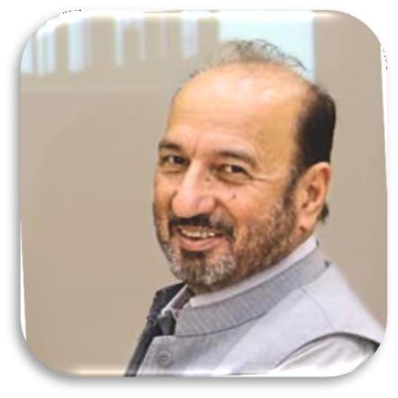



Message:
Project Director/Principal- Mohsin ul Mulk
The Government of Pakistan is committed to overcome the
country energy crises by the year 2020-2025 and to generate more than 30,000 MW electricity through diversified means including Oil and Gas. By 2025 Government of KP has set production targets of 200,000 BPD oil, 2,000 MMCFD gas, and 3,000 TPD LPG. To achieve these targets, there is need of investment in capacity building of local human resource and generation of skilled work force where currently there is no formal Institute in KP to generate skilled technicians and drillers required for Oil & Gas production sector.
To address the real time issue of non-availability of local skilled technicians required for drilling operations in the Oil and Gas producing areas of Pakistan and particularly KP, a project “Establishment of Institute of Petroleum Technology (IPT) Karak is initiated under PSDP funding of Finance Division, Govt. of Pakistan, executed by Energy & Power Department, Government of KP via KPOGCL in close collaboration with KP TEVTA.
Institute of petroleum technology is one of the youngest Institute established in Khyber Pakhtunkhwa, Pakistan which is offering immense educational, technical and research opportunities in the field of core technologies related to Oil & Gas sector. The Institute inventory and labs are equipped with state of the art equipment required for producing skilled work force and have effective field level coordination with the Oil and Gas sector exploration and production companies currently engaged in the Southern Districts of KP to get benefit of transforming on job technical skills to the student of IPT through demonstrations. Continued…

Slide 2
Institute of Petroleum Technology Karak is offering 3 Year Diploma of Associate Engineer (DAE) in Drilling and Drilling Fluids as of academic session 2022/23 under formal affiliation with KP Board of Technical & Commerce Education Peshawar and has developed coordination network with KP TEVTA, NAVTTC, KPOGCL and OGDCL for academics courses & curriculum and for field level exposures of the students and faculty to the exploration and production sites of Oil and Gas in Southern Districts of KP. The Institute of Petroleum Technology (IPT) Karak shall be expending its DAE Program to Petroleum, Mechanical and Electrical & Instrumentation Technologies and later on to include Chemical and Petro-Chemical technologies.
The Institute is staffed with competent faculty & well equipped labs to provide modern day technical skills and to bridge Academia and Industry to target the real time training issues of technicians & mid level staff of the Oil and Gas sector. The Institute of Petroleum Technology believes that its faculty and the students shall contribute in the technological needs of the country and shall develop skilled work force of technicians for the Oil and Gas Sector. We are also cognizant of the interlinking and accreditation needs of the sector with the international technical and training institutes with regard to research. For the fast growth of the institution, we have adapted to promote core values of Merit, Integrity, Team Work, Safety, Dedications and innovations.
We are confident of the Institute success with support of KPOGCL, KP-TEVTA, E&P Department and Government of KP at large and blessing of the Almighty Allah.
THANK YOU

Slide 3





PRIMARY FUNCTIONS OF THE INSTITUTE
Facilitate in capacity building for development of conventional & unconventional petroleum and related hydraulic fracking sectors.
The Institute shall responsible for dealing with all the technical capacity building
matter relating to petroleum, gas,
and condensate processing and plants related affairs.
Matters bearing on international aspects like technology advancements & development in the field of Petroleum Technology.
To ensure the workforce generation like technicians, mechanics, fitters and drillers, etc.
To ensure the jobs and employment for mid-level skilled workforce.
To meet the industry standard and requirement for the mid-level training and workforce development.

Slide 4
IPT STAFF
Name | Position
Mr. Mudassar Rauf | Office Assistant
Mr. Muhammad Ismail Shah | Head Clerk
Mr. Fiaz Ahmad | Head Clerk
Mr. Kamran Khalil | Junior Clerk
Mr. Wajid Ullah | Junior Clerk
Mr. Rehmat Ullah | Junior Clerk
Mr. Saeed Ur Rehman | Technician
PRINCIPAL, FACULTY & ADMIN. STAFF
SUPPORTING STAFF
Name | Position
Mr. Mohsin ul Mulk | Project Director/Principal
Mr. Arif Ullah | Deputy Director Fin/ Acc.
Mr. Adnan Ahmed | In-Charge Academics
Mr. Fahim Ullah Khan | Assistant Professor
Mr. Sami Ullah | Lecturer
Mr. Muhammad Aqeel | Lecturer
Mr. Muhammad Kashif | Lecturer
Mr. Adnan Qadir | Assistant Director Works
Mr. Muhammad Atif Khattak | Assistant Director Fin/ Acc.
Mr. Ayaz Muhammad | Admin Officer
Mr. Tariq Nadeem | Procurement Officer
Mr. Tariq Azam | Network Administrator

Slide 5
IPT, Academic Management Committees
Scrutiny Committee
Admission Committee
Discipline Committee
Chairman
Mr. Mohsin ul Mulk Project Director/Principal
Chief Proctor Mr. Sami Ullah Lecturer
Member
Mr. Sami Ullah
Lecturer
Member
Mr. Arif Ullah
Deputy Director Fin/ Acc.
Member
Mr. Muhammad Aqeel
Lecturer
Proctor
Mr. Muhammad Aqeel Lecturer
Member
Mr. Fahim Ullah Khan
Assistant Professor
Member
Mr. Muhammad Kashif
Lecturer
Student Proctor
Member
Mr. Adnan Ahmad Lecturer/Secretary

Slide 6
TECHNOLOGIES & DISTRIBUTION OF SEATS
Institute of Petroleum Technology (IPT) offers 3 years DAE program in Drilling and Drilling Fluids Technology. The Seats distributions is given as below.
Distribution of Seats
S. No | Details | Drilling & Drilling Fluids | Total
1 | KPK | 20 | 20
2 | Punjab | 05 | 05
3 | Sindh | 05 | 05
4 | Baluchistan | 05 | 05
5 | AJK | 01 | 01
6 | Gilgit Baltistan | 01 | 01
7 | Ex FATA | 01 | 01
8 | Disable | 01 | 01
9 | Minorities | 01 | 01
 | Total |  | 40

Slide 7
ADMISSION POLICY
Admission in DAE program is on Open Merit basis, based on the following terms and conditions;
Candidates from all over the Pakistan are eligible to apply on open
merit as per regional seats allocations. Admission will be purely based
Eligibility
on marks obtained in SSC (Science Group). Ten marks per year will be deducted from the candidate who has passed SSC exam before current academic year.
The lower and upper age limits for the applicant are 16 and 25 years respectively as per KP BT&CE Peshawar. In case two candidates having same percentage in the merit list, preference will be given to the applicant senior in age. Applications against regional allocated seats must reach the Institute before closing date, otherwise reserve quota
Age
seats will be converted to open merit.

Slide 8
ADMISSION PROCEDURE
The last date for admission is announced by Management of the Institute through an advertisement in which a complete schedule is given. All applicants are advised to read all the instructions in prospectus as well as admission form and fill the admission form carefully. The attested copies of the following documents must be attached with admission form.
Important Note:
The student can cancel the admission within 14 days of the commencement of classes and will be able to refund his admission fee. Fees will not be refunded in case of failure to cancel the admission within the stipulated time.
SSC Certificate
DMC SSC
(02 Photo Copies)
(03 Photo Copies)
(01 Photo Copy)
(01 Photo Copy)
(01 Photo Copy)
(01 Photo Copy)
(05 Photos)
viii. Student Affidavit (01 Photo Copy)
ix. Migration Certificae from the BISE to KP-BTE Peshawar.
Domicile Certificate
Character Certificate
CNIC/ B-Form
Father/Guardian CNIC
Candidate Photograph

Slide 9
Fee Structure
Institute Fee
1 | Admission Fee (Per Annum) | 1000
2 | Tuition Fee (Per Annum) | 1800
3 | Library Fee (Per Annum) | 1000
4 | IT Lab Charges (Per Annum) | 500
5 | Field Work Fund (Per Annum) | 550
6 | Lab Charges (Per Annum) | 1000
7 | Security (Refundable) (Once for 03 Years) | 1000
8 | Other Charges (Per Annum)
Sub Total |  | 6850/- (PKR)
 | KP BT&CE Fee
1 | Board Registration Fee (Once in 03 Years) | 890
2 | Board Diploma (Once in 03 Years) | 490
3 | Board Sports Fee (Once in 03 Years) | 520
Sub Total |  | 1900/- (PKR)
8750/- (PKR)
Net Amount ( Board + Institute Fee)
Note: The fee can be revised subject to policy decision of the Government, KP BT&CE, KP TEVTA and Institute.

Slide 10
STUDENT ATTENDENCE
Readmission opportunities can be availed twice in an Academic year. Students are bound to ensure Readmission within 14 working days after struck off
A student is required get overall 80% attendance in all subjects. PKR 50 fine will be charged per class for absence from class
The I/charge Academic can grant 5% concession in attendance in exceptional and desiring case.
All the students must attend the theory/
practical classes regularly.
Continuous absence of six days from class will lead for the struck off from the institute.
Readmission fee for 1st time is PKR 1500.
Which gets
double on 2nd time.
UNIFORM
SUMMER:
WINTER:
White Shalwar, Qameez or Pent Shirt with black Shoes (as per TEVTA precedence)
White Shalwar, Qameez or Pent Shirt with black Coat & Shoes (as per TEVTA precedence)

Slide 11
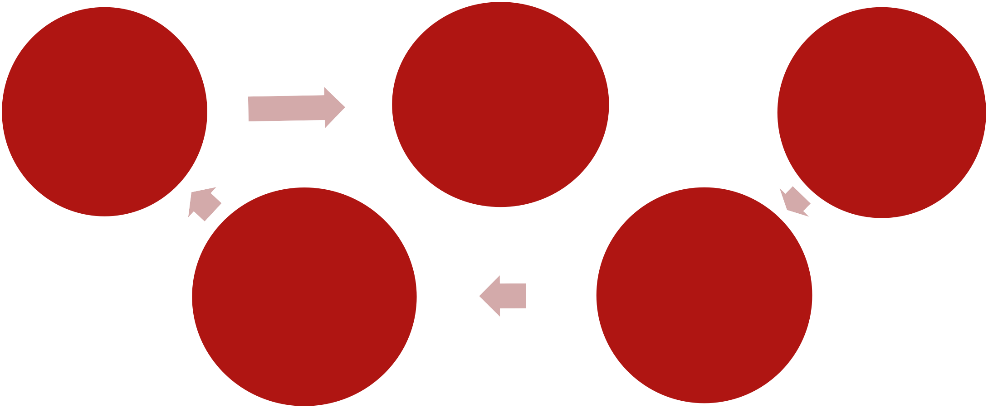
Institute Rules for Enrolled Students
All those students who makes offence repeatedly will be struck off from the institute.
All the students must wear proper Institute uniform.
All the
student’s must have Institute identity card.
The student’s violating the Institute rules will be fines ranging from PKR 100 to 500 depending on the nature of offence.
Use of mobile phones is strictly banned in the Institute premises.

Slide 12
SCHEME OF STUDIES 3-YEARS (DAE) DRILLING AND DRILLING
FLUIDS TECHNOLOGY
FIRST YEAR
S.No. | Subject Codes | Subject Name | Theory | Practical
1 | Gen-111 | Islamiat & Pak Study | 1 | 0
2 | Eng.- 112 | English | 2 | 0
3 | Math-113 | Applied Mathematics-1 | 3 | 0
4 | Phy-123 | Applied Physics | 2 | 3
5 | Chem-133 | Applied Chemistry | 2 | 3
6 | Comp-142 | Computer Application | 1 | 3
7 | PCT-103 | Basic Engineering Drawing & AutoCAD | 1 | 6
8 | DFT-103 | Fundamental of Drilling Technology | 2 | 3
9 | PET-123 | Workshop Practice | 1 | 6
10 | DFT-113 | Occupational HSE | 3 | 0

Slide 13
Continued…..
SECOND YEAR
S.No. | Subject Codes | Subject Name | Theory | Practical
1 | Gen-211 | Islamiat & Pak Studies | 1 | 0
2 | Math-223 | Applied Mathematics | 3 | 0
3 | Mgm-201 | Technical Report Writing | 1 | 0
4 | PCT-203 | Fluid Mechanics & Thermodynamics | 2 | 3
5 | DFT-203 | Applied Geology | 2 | 3
6 | DFT-213 | Casing & Cementing | 2 | 3
7 | DFT-223 | Drilling Fluids-1 | 2 | 3
8 | DFT-233 | Rotary Drilling | 2 | 3
9 | DFT-243 | Drill String Technology | 2 | 3
10 | DFT-251 | Work Shop in Drilling Technology | 0 | 3

Slide 14
Continued…..
THIRD YEAR
S.No. | Subject Codes | Subject Name | Theory | Practical
1 | Gen-311 | Islamiat & Pak Studies | 1 | 0
2 | IMH-311 | Industrial Management & Human Relation | 2 | 0
3 | DFT-303 | Introduction to Petroleum Technology | 2 | 3
4 | DFT-313 | Drilling Fluids-2 | 2 | 3
5 | DFT-323 | Directional Drilling & Application | 2 | 3
6 | DFT-333 | Drilling Simulation | 1 | 6
7 | DFT-343 | Well Completion | 2 | 3
8 | DFT-351 | Drilling Economics | 1 | 0
9 | DFT-362 | Mechanics of Material | 1 | 3
10 | DFT-373 | Petroleum Geology & Stratigraphy | 2 | 3

Slide 15
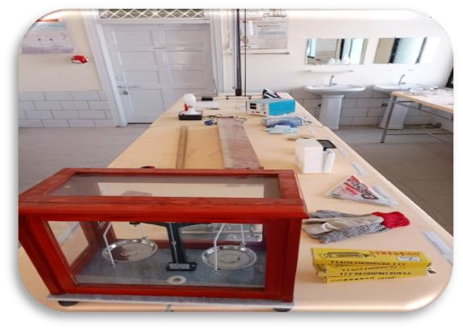
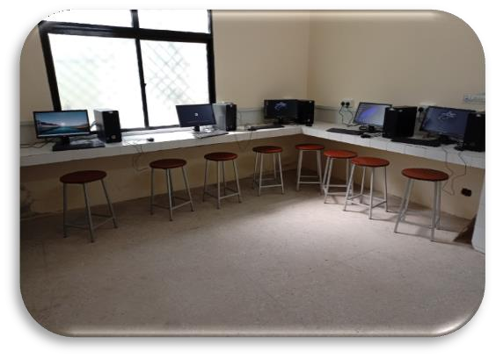
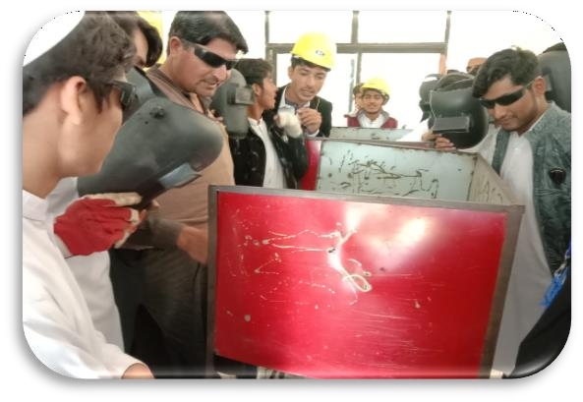
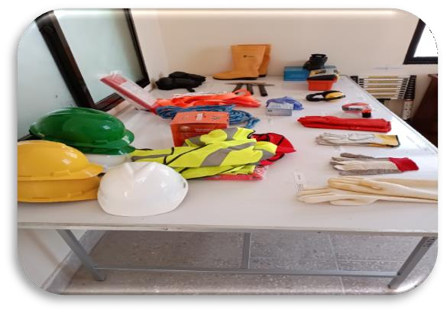
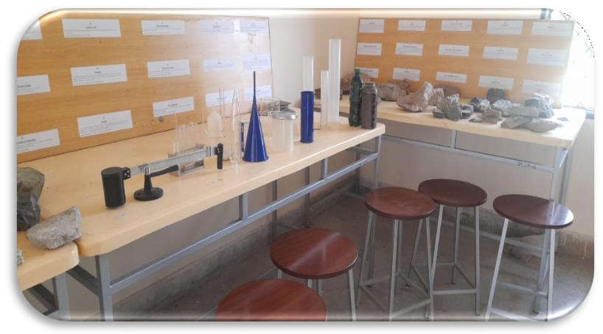
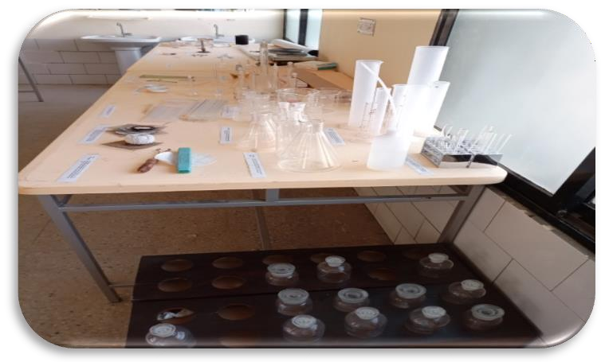
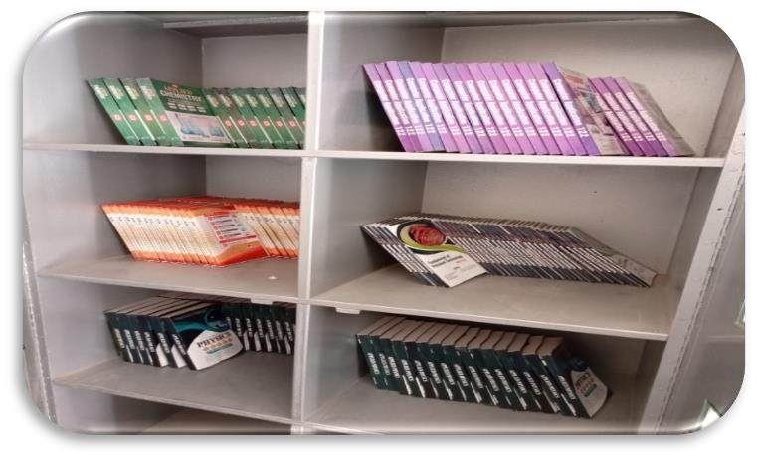
Photos Gallery
Physics Lab
Computer Lab
Machine Shop
Health & Safety Lab
Drilling Fluids & Geology Lab
Chemistry Lab
Library

Slide 16
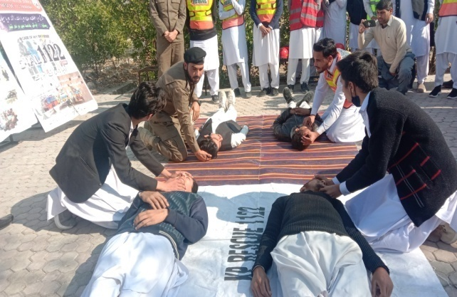
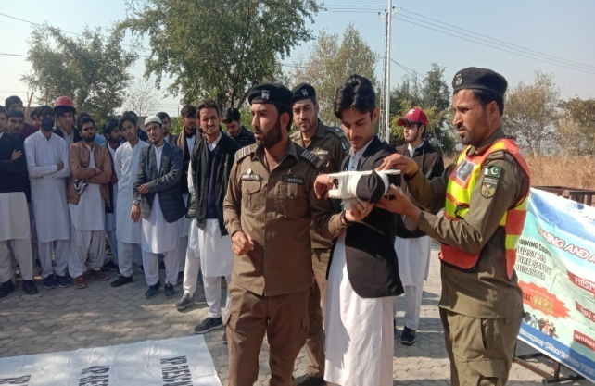
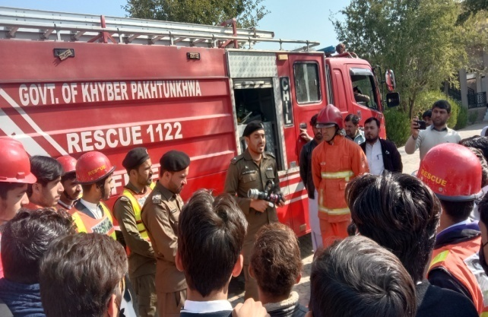
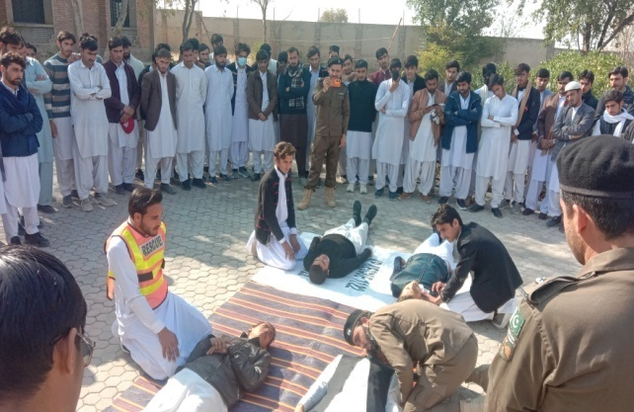
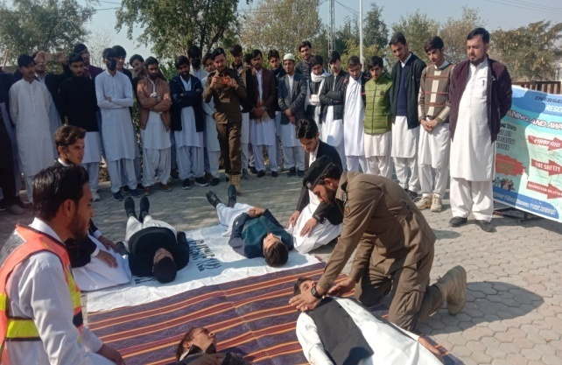
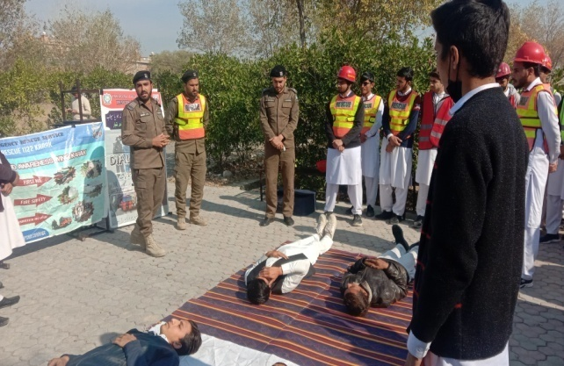
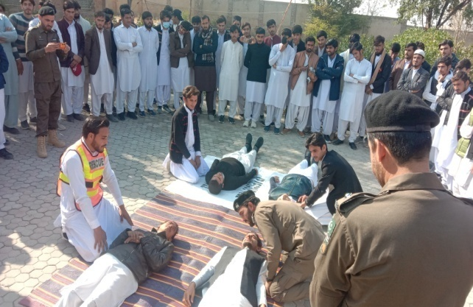
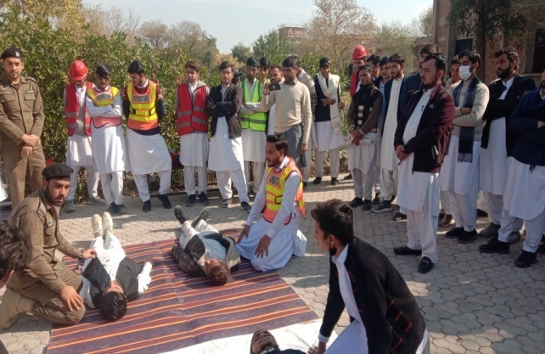
Continued….
Basic Life Support Training (Rescue 1122 & Civil Defense)

Slide 17
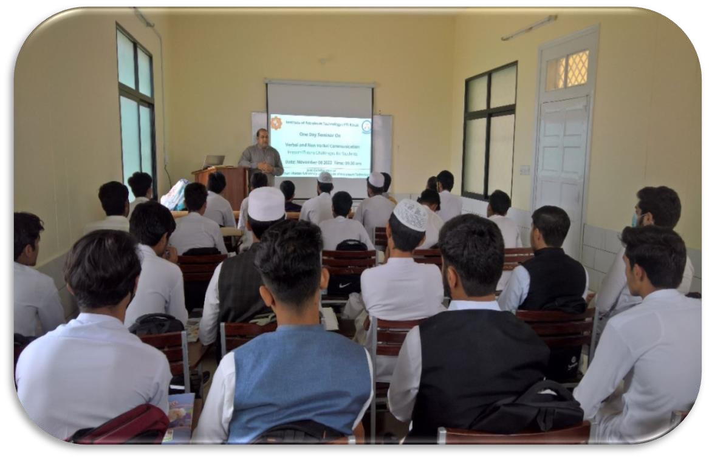
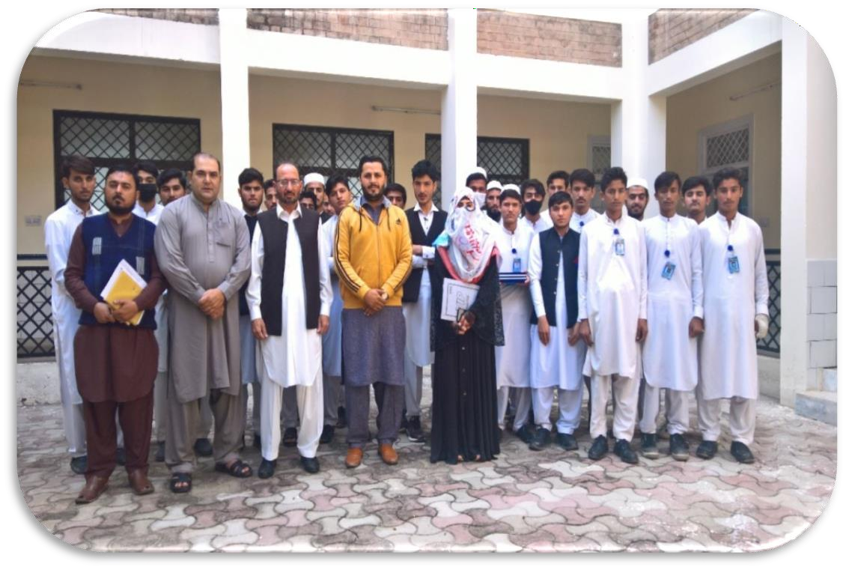
Continued…..
Seminar on Verbal and Non Verbal Communication

Slide 18
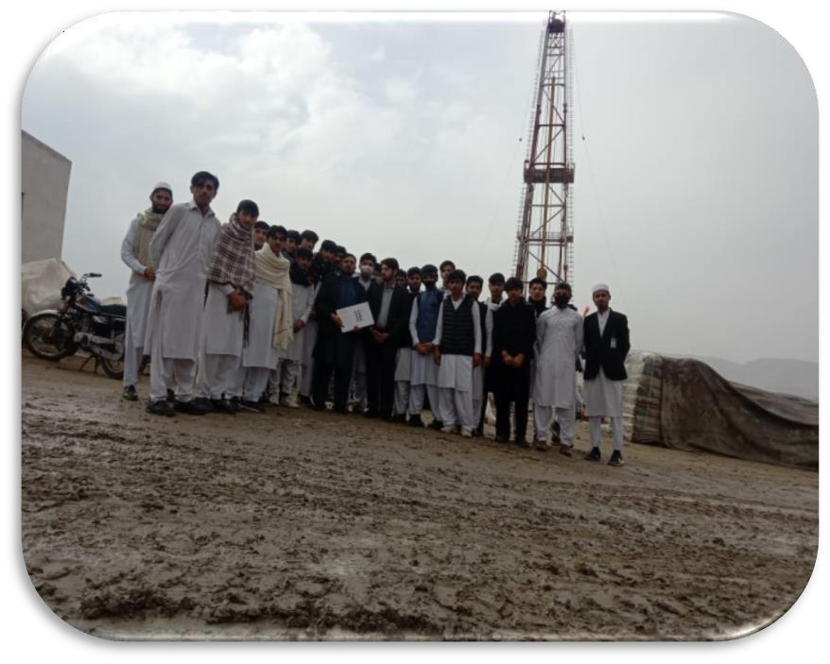
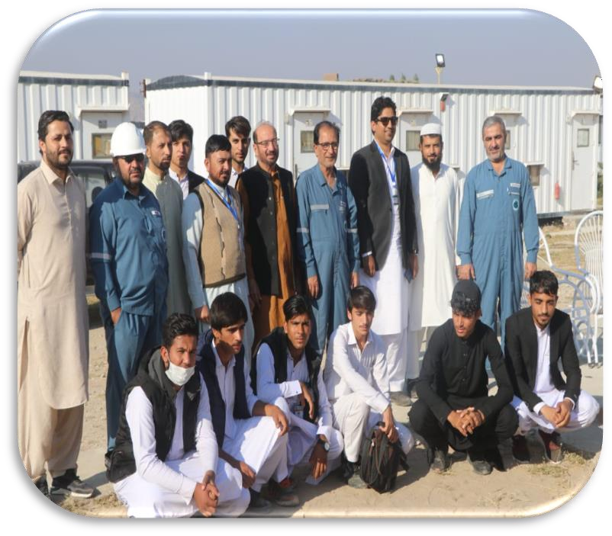
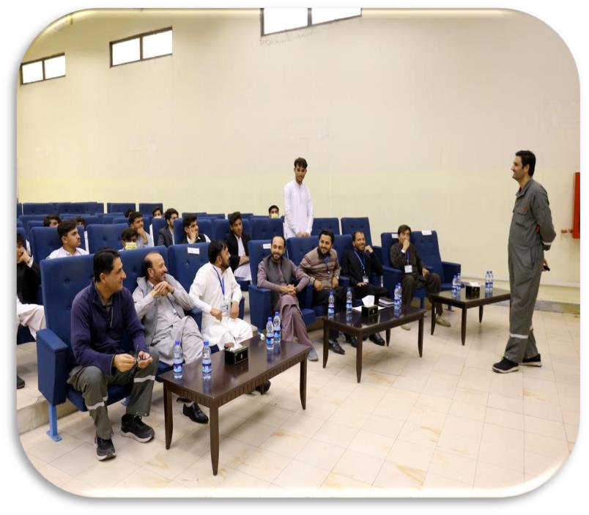
Continued…..
Study Visits:
OGDCL NASHPA N5 Rig
OGDCL NASHPA CAMP OFFICE
MOL PAKISTAN CPF MAKORI

Slide 19
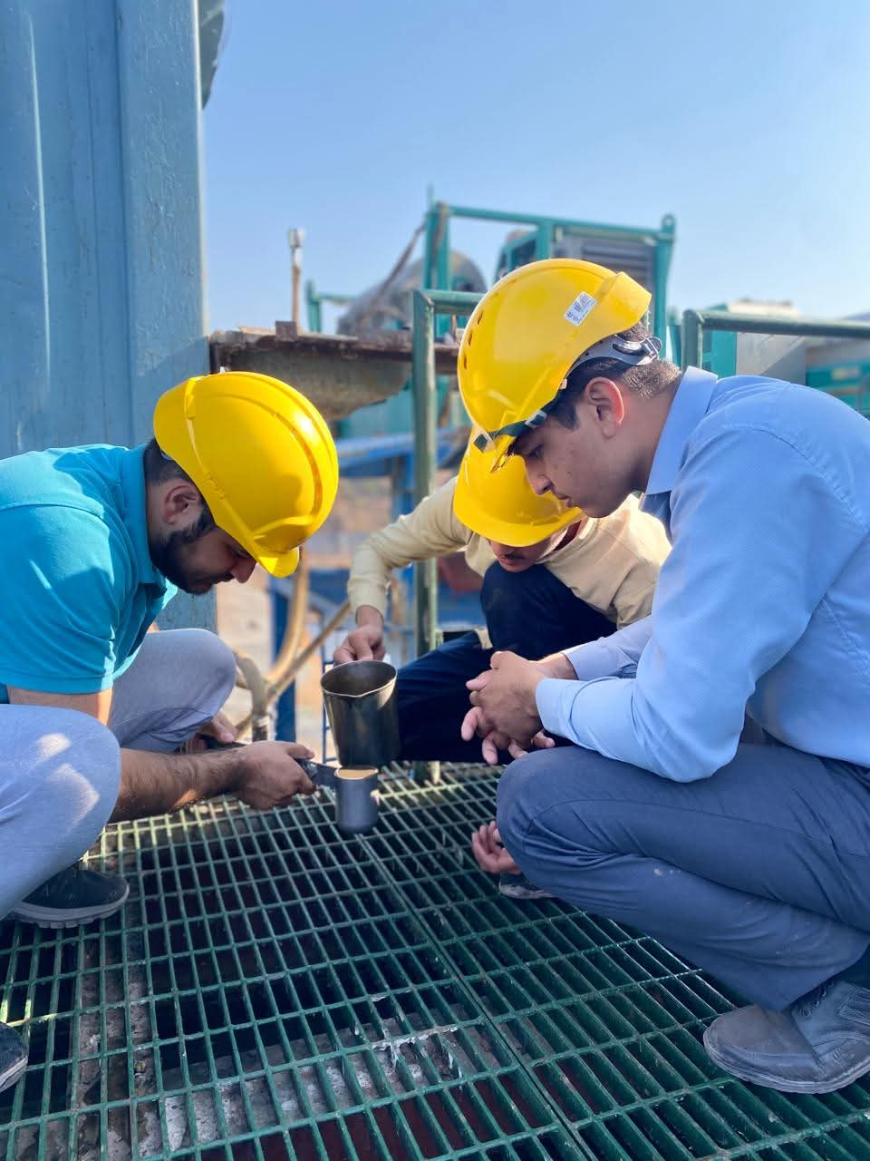
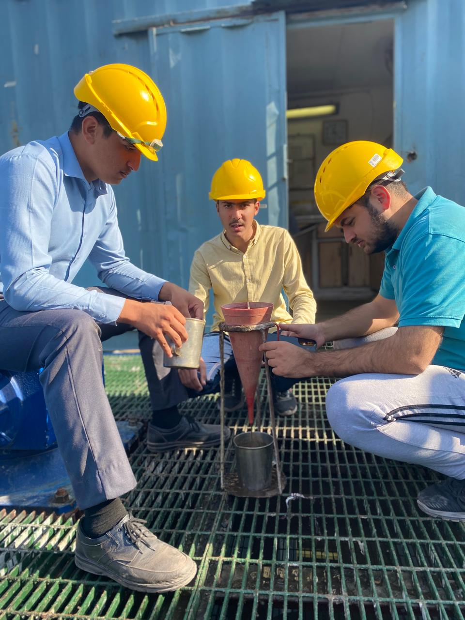
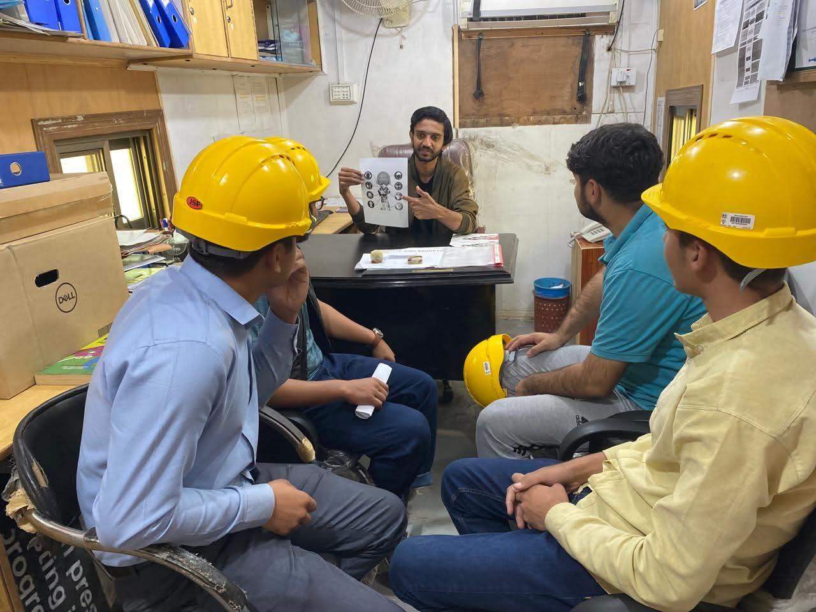
Continued…..
Field Internship

Slide 20
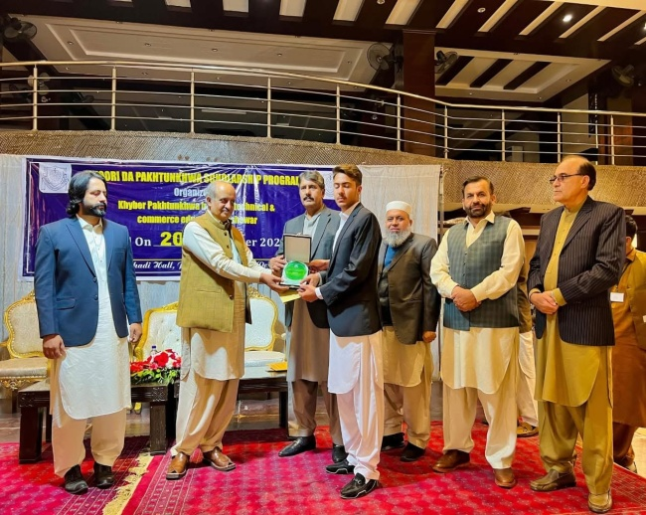
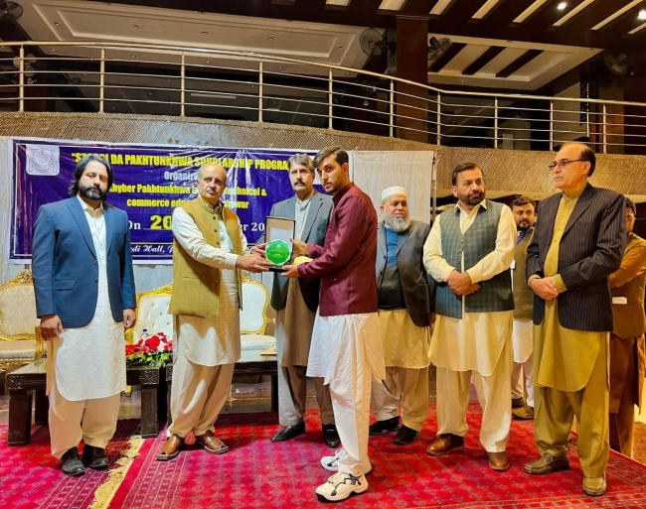
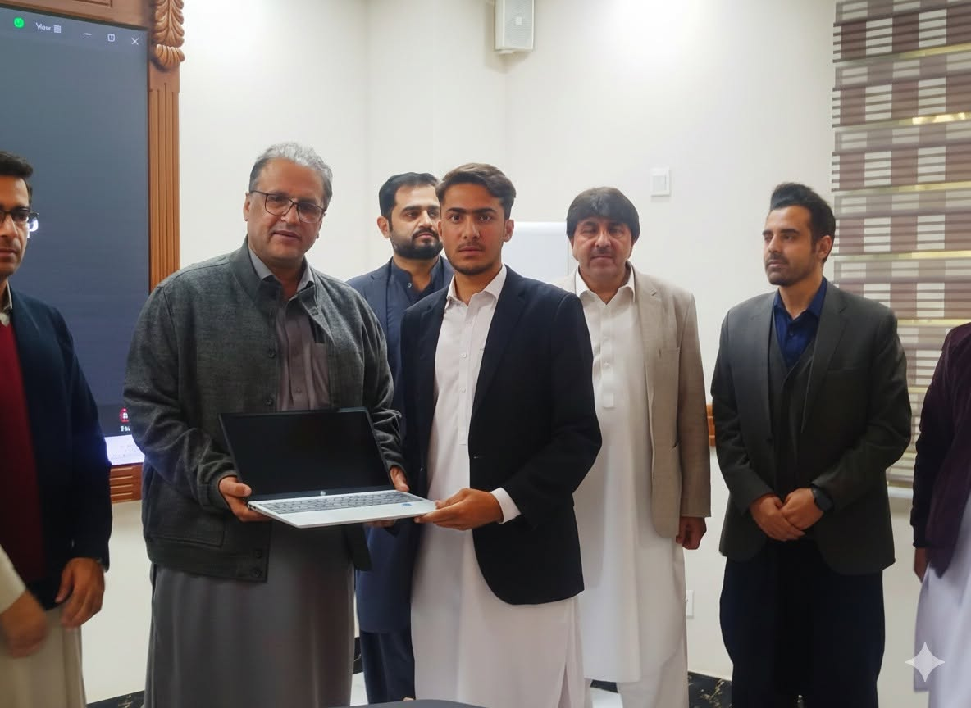
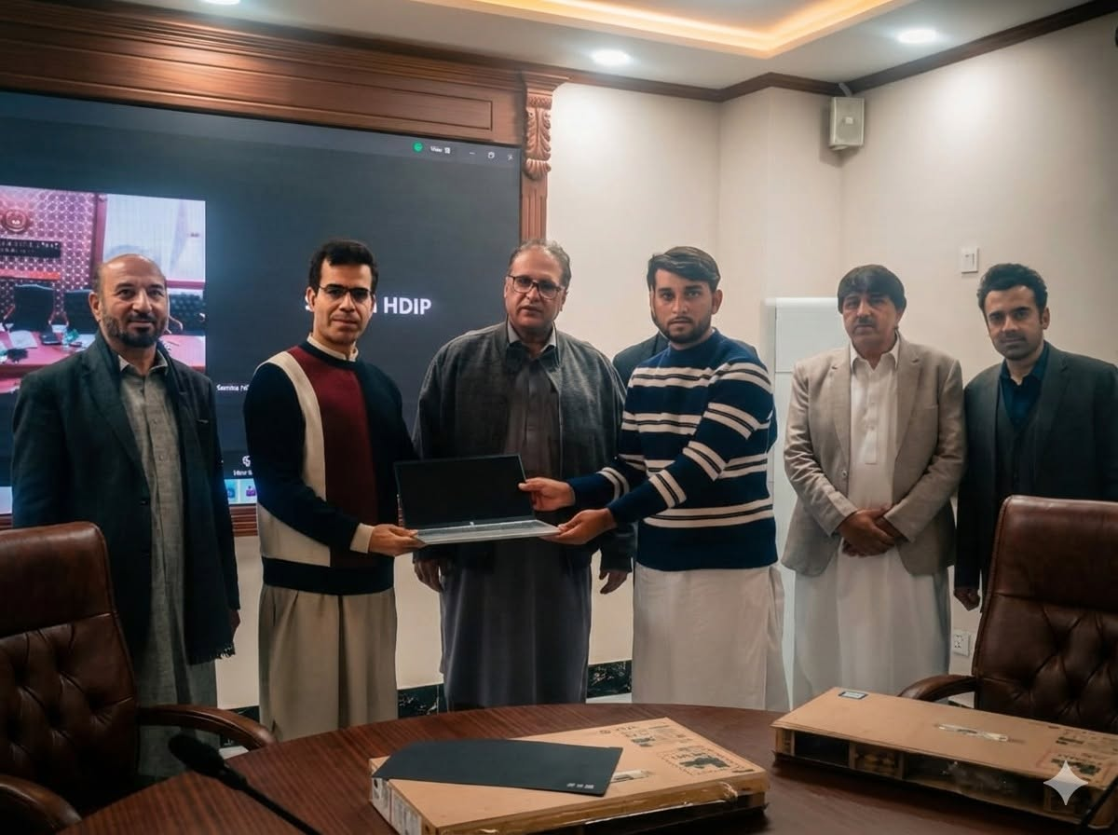
Continued…..
𝐏𝐫𝐨𝐮𝐝 𝐌𝐨𝐦𝐞𝐧𝐭 𝐟𝐨𝐫 𝐈𝐏𝐓 Karak
Our Students Shine Bright with 1st & 3rd Positions in DAE Annual Exam 2025, Board of Technical & Commerce Education Peshawar.
Energy & Power and 𝐊𝐏-𝐎𝐆𝐂𝐋 𝐡𝐚𝐬 𝐚𝐰𝐚𝐫𝐝𝐞𝐝 𝐥𝐚𝐩𝐭𝐨𝐩𝐬 𝐭𝐨 𝟏𝐬𝐭 & 𝟑𝐫𝐝 𝐩𝐨𝐬𝐢𝐭𝐢𝐨𝐧 𝐡𝐨𝐥𝐝𝐞𝐫 𝐢𝐧 𝐁𝐓&𝐂𝐄 𝐚𝐧𝐧𝐮𝐚𝐥 𝐞𝐱𝐚𝐦
𝟐𝟎𝟐𝟓.

